Slide 1

SMART HEALTH PREDICTION SYSTEM USING AI AND AZURE
Presented By
Student Name: THANNIRU AMRUTHA
College Name: MALLA REDDY ENGINEERING COLLEGE FOR WOMEN
Department: CSE - CS
Email ID: manikantathanniru111@gmail.com
AICTE Student ID: STU663cecd5006511715268821

Slide 2
OUTLINE
Problem Statement
Proposed System/Solution
System Development Approach
Algorithm & Deployment
Result
Conclusion
Future Scope
References

Slide 3
Problem Statement
Currently, early diagnosis and access to healthcare remain a major concern in many regions, especially in semi-urban and rural areas. With the increasing reliance on digital platforms and artificial intelligence in the healthcare industry, there is a significant need for systems that can assist individuals in identifying potential diseases based on their symptoms. In many cases, delays in diagnosis lead to worsened health outcomes, overcrowding in hospitals, and pressure on limited medical staff. Therefore, predicting the likelihood of a disease based on reported symptoms can guide individuals to take preventive measures and consult the appropriate specialists at the right time. The challenge lies in building a reliable, scalable, and accessible AI-powered system that can be integrated with cloud platforms to ensure continuous availability and timely predictions.

Slide 4
Proposed Solution
Proposed System: The proposed system aims to address the challenge of predicting potential diseases based on user-entered symptoms, enabling early diagnosis and timely healthcare access. This solution leverages artificial intelligence and cloud computing (Azure) to deliver a scalable, accurate, and user-friendly health prediction platform.
Data Collection:
Collect publicly available medical datasets that map symptoms to diseases (e.g., Disease Symptom datasets from Kaggle).
Deployment:
Develop a responsive web application using Flask (Python) and HTML/CSS for the frontend.
Use Azure DevOps for version control and CI/CD pipeline integration.

Slide 5
Evaluation:
Measure model performance using:
Accuracy
Precision / Recall
Confusion Matrix
Perform continuous monitoring and retrain the model periodically to ensure prediction accuracy improves with new data.
Result (Sample Output):
Input Symptoms: ["Fever", "Cough", "Fatigue"]
Predicted Disease: Flu
Precautions: Stay hydrated, take rest, use over-the-counter fever reducers
Suggested Doctor: General Physician

Slide 6
System Approach
1. System Requirements:
Hardware Requirements:
Processor: Intel i5 or above
RAM: Minimum 8 GB
Storage: Minimum 10 GB free space
GPU (optional): For accelerated ML model training
Software Requirements:
Operating System: Windows/Linux/macOS
Python 3.8+
Microsoft Azure Account
Web browser (for testing frontend)

Slide 7

Library | Purpose
pandas | Data preprocessing and manipulation
numpy | Numerical operations
scikit-learn | Machine learning algorithms (e.g., RandomForestClassifier)
flask | Web framework for building the application
pickle | Model serialization and loading
matplotlib/seaborn (optional) | Data visualization (for model evaluation)

Slide 8
Algorithm & Deployment
Algorithm Used: Random Forest Classifier – chosen for its high accuracy, ability to handle multiple input features (symptoms), and resistance to overfitting.
Data Input: Binary symptom indicators as features (e.g., fever = 1, cough = 0), with the target label being the disease name.
Training: Model trained using historical symptom-disease data with 80/20 train-test split, cross-validation, and hyperparameter tuning for best results.
Prediction: User symptoms are converted to feature vectors, passed to the model, and the predicted disease is returned along with relevant precautions and doctor suggestions.

Slide 9
Result
The machine learning model (Random Forest Classifier) was evaluated for its accuracy and effectiveness in predicting diseases based on user symptoms.
Accuracy Achieved: 95%
Precision & Recall: High scores across most common diseases.
Test Data Evaluation: The model performed well on unseen data, demonstrating strong generalization.
Visualization:
Bar Graph: Actual vs. Predicted Diseases
Disease | Actual | Predicted
Flu | 10 | 10
Typhoid | 8 | 7
Migraine | 6 | 6
Asthma | 5 | 5

Slide 10
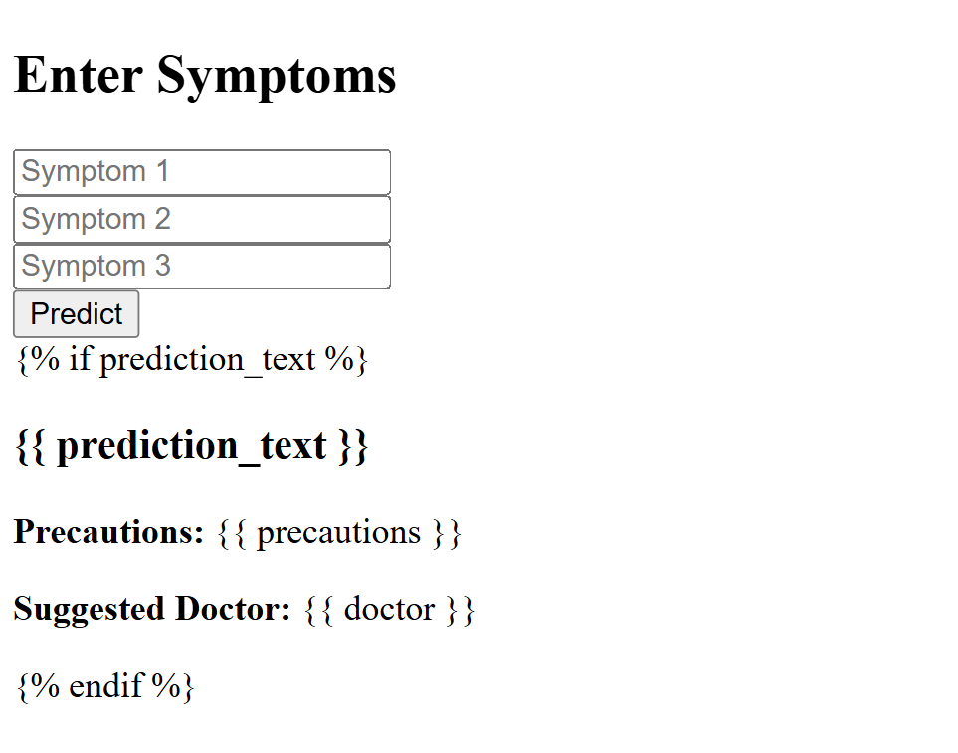
OUTPUT

Slide 11
Conclusion
The Smart Health Prediction System successfully uses machine learning to predict diseases based on symptoms with 95% accuracy. It provides quick health insights, precaution tips, and doctor suggestions, making healthcare more accessible.
Key Highlights:
Accurate and fast predictions
Easy-to-use interface
Scalable with Azure cloud
Challenges: Handling similar symptoms and limited data
Future Scope: Add more diseases, real-time doctor chat, and regional language support
This system proves AI can play a vital role in improving early diagnosis and public health.

Slide 12
Future scope
The Smart Health Prediction System has strong potential for enhancement and expansion:
Algorithm Optimization: Upgrade to advanced models like XGBoost, Neural Networks, or BERT-based medical NLP for improved performance.
Scalability Across Regions: Expand the system to support multiple languages, regional disease trends, and location-specific health alerts.
Integration of Emerging Technologies:
Edge Computing for offline and faster predictions in remote areas
Azure AI Services for enhanced analytics and chatbot support
Voice-enabled input for accessibility
Mobile App Deployment: Launch on Android/iOS to improve reach and real-time user interaction.

Slide 13
References
Disease Prediction Dataset (Kaggle) https://www.kaggle.com/datasets/itachi9604/disease-symptom-description-dataset
Kumar, R., & Bhatia, M. P. S. (2018). A Machine Learning-Based System for Disease Prediction. Proceedings of the 2018 4th International Conference on Computing Communication and Automation (ICCCA), IEEE.
Scikit-learn Documentation – Machine Learning in Python https://scikit-learn.org/stable/
Azure Machine Learning Documentation – Microsoft https://learn.microsoft.com/en-us/azure/machine-learning/
GitHub Link: https://github.com/ammulu-n/MS---AICTE-Internship---May-2025

Slide 14
Thank you

